Slide 1

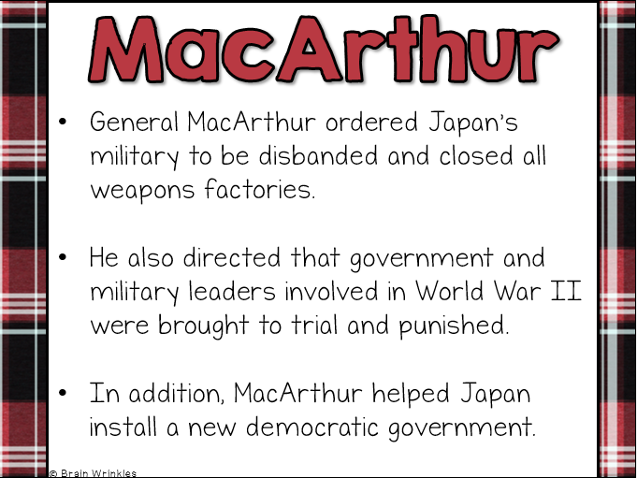
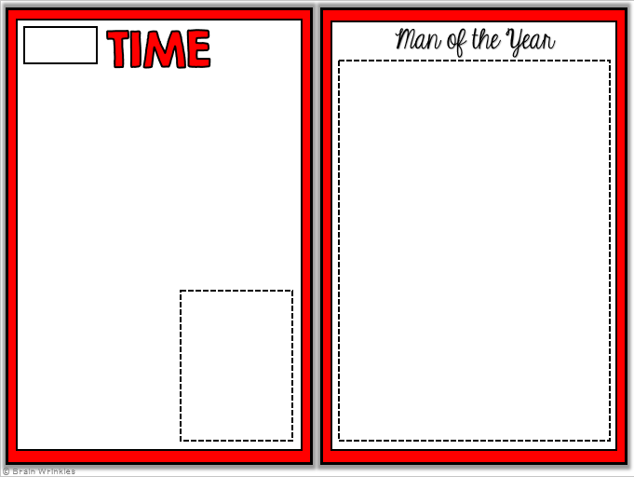
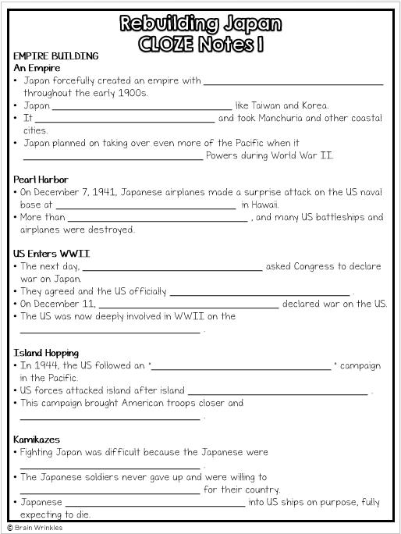

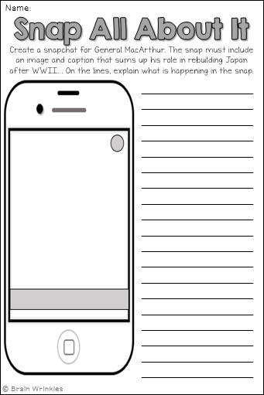
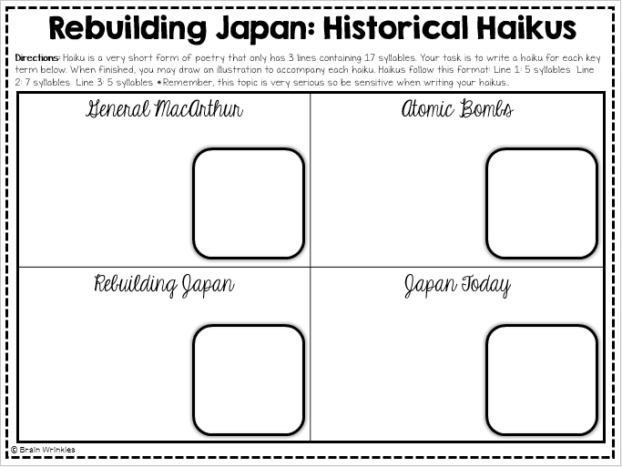
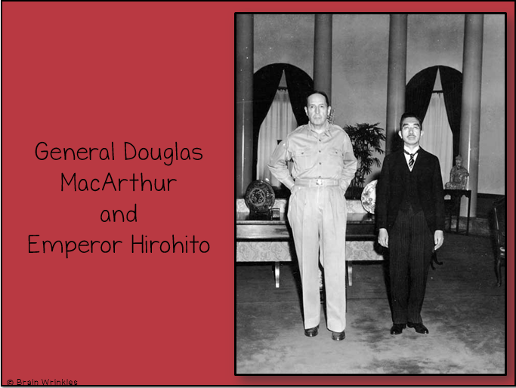
REBUILDING
JAPAN
REBUILDING
JAPAN
Presentation, Graphic Organizers, & Activities

Slide 2
STANDARDS:
SS7H3 Analyze continuity and change in Southern and Eastern Asia.
c. Explain the role of the United States in the rebuilding of Japan after WWII.
© Brain Wrinkles

Slide 3
TEACHER INFO: CLOZE Notes
The next pages are handouts for the students to use for note-taking during the presentation. (Print front to back to save paper and ink.)
Check the answers as a class after the presentation.
© Brain Wrinkles

Slide 4
EMPIRE BUILDING
An Empire
Japan forcefully created an empire with ________________________________ throughout the early 1900s.
Japan ________________________________ like Taiwan and Korea.
It ________________________________ and took Manchuria and other coastal cities.
Japan planned on taking over even more of the Pacific when it ________________________________ Powers during World War II.
Pearl Harbor
On December 7, 1941, Japanese airplanes made a surprise attack on the US naval base at ________________________________ in Hawaii.
More than ________________________________ , and many US battleships and airplanes were destroyed.
US Enters WWII
The next day, ________________________________ asked Congress to declare war on Japan.
They agreed and the US officially ________________________________ .
On December 11, ________________________________ declared war on the US.
The US was now deeply involved in WWII on the ________________________________ .
Island Hopping
In 1944, the US followed an “________________________________ ” campaign in the Pacific.
US forces attacked island after island ________________________________ .
This campaign brought American troops closer and ________________________________ .
Kamikazes
Fighting Japan was difficult because the Japanese were ________________________________ .
The Japanese soldiers never gave up and were willing to ________________________________ for their country.
Japanese ________________________________ into US ships on purpose, fully expecting to die.
© Brain Wrinkles
Rebuilding Japan
CLOZE Notes 1

Slide 5
Iwo Jima
In February 1945, American forces invaded the ________________________________ .
The island was important because it was ________________________________ and it was a good place for US planes to land.
The Japanese protected the island with ________________________________ .
It was a fierce battle, but the ________________________________ eventually took the island.
Atomic Bombs
The Allies thought about invading Japan, but were worried that too many ________________________________ .
________________________________ made a difficult decision to use nuclear weapons against Japan.
He warned the Japanese government to surrender, but they ________________________________ .
On August 6, 1945, an American bomber plane dropped the first atomic bomb ever used in war on the ________________________________ .
A few days later, the US dropped a ________________________________ .
Both cities were ________________________________ , and the Japanese finally agreed to surrender.
Japan is the ________________________________ in the world that has been attacked by nuclear weapons.
VJ Day
The two sides signed formal surrender papers on the US battleship Missouri on ________________________________ .
This day is known as VJ Day – ________________________________ – and it officially put an end to Japan’s empire-building.
REBUILDING JAPAN
Destruction
After Japan’s surrender, Japan’s ________________________________ were devastated.
The country’s ________________________________ (transportation, communication, sewage, water, and electric systems) was demolished.
________________________________ and the emperor was exposed as a mere mortal and not a god.
© Brain Wrinkles
Rebuilding Japan
CLOZE Notes 2

Slide 6
Occupation
The US had a plan to occupy and rebuild Japan in a way that would guarantee the country would ________________________________ to others in the future.
________________________________ was sent to oversee Japan’s restoration.
The US occupied Japan from ________________________________ .
MacArthur
General MacArthur ordered Japan’s military to be disbanded and ________________________________ .
He also directed that government and military leaders involved in World War II were brought to ________________________________ .
In addition, MacArthur helped Japan install a new ________________________________ .
Government
MacArthur decided that Japan would be a ________________________________ in order to preserve the emperor’s role in the country’s culture.
He wrote Japan’s constitution, The MacArthur Constitution, which is still considered one of the ________________________________ in the world today.
Japanese citizens were granted many of the ________________________________ .
Reparations
Japan’s constitution also prevents the country from ________________________________ of fighting with other countries (unless they are attacked first).
After signing the new constitution, the Japanese government pledged to ________________________________ to the countries that they harmed during WWII.
The Japanese were also ________________________________ in any way.
Support
The United States offered ________________________________ to help kick start Japan’s economy after World War II.
The US invested ________________________________ into rebuilding Japan.
Not all Americans supported the expense, but the government ________________________________ to help Japan rebuild.
The US government knew that a friendly Japan would be a ________________________________ in the future.
© Brain Wrinkles
Rebuilding Japan
CLOZE Notes 3

Slide 7
Communism
The US government also wanted a democratic government to counteract the ________________________________ in Southern and Eastern Asia.
Communism was getting more and more popular in ________________________________ , Korea, and Vietnam.
The US government saw this as a ________________________________ , and desired to keep the Japanese from being drawn to Communism.
Economy
The United States’ efforts, coupled with a strong ________________________________ , led to a boom in Japan’s economic growth.
Japan now has one of the most ________________________________ in the world.
America’s occupation and MacArthur’s rebuilding of Japan has had a ________________________________ .
Today
On April 28, 1952, Japan became a fully ________________________________ .
Today, the country has one of the most ________________________________ in the world.
The US and Japan have remained close ________________________________ since the 1950s.
© Brain Wrinkles
Rebuilding Japan
CLOZE Notes 4

Slide 8

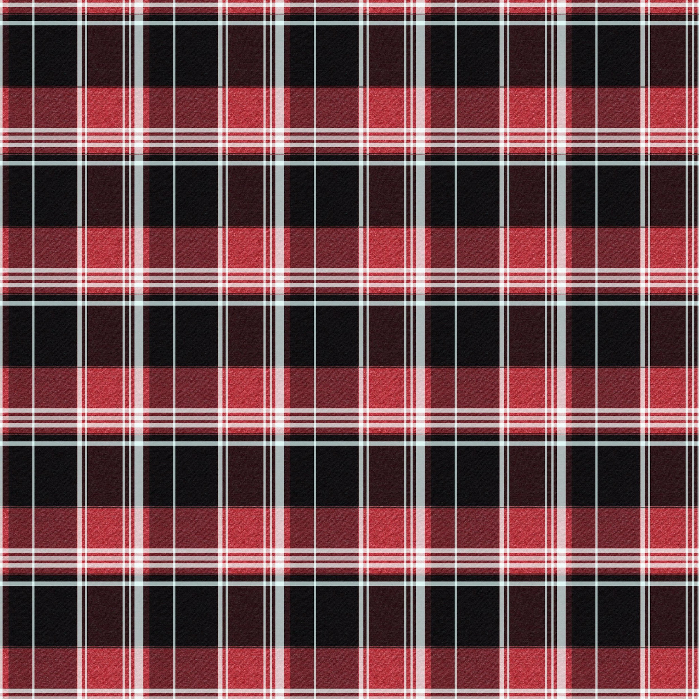
Rebuilding
JAPAN
© Brain Wrinkles

Slide 9
EMPIRE
Building
© Brain Wrinkles

Slide 10
An Empire
Japan forcefully created an empire with military strength throughout the early 1900s.
Japan captured Asian regions like Taiwan and Korea.
It invaded China and took Manchuria and other coastal cities.
Japan planned on taking over even more of the Pacific when it joined the Axis Powers during World War II.
© Brain Wrinkles

Slide 11
Pearl Harbor
On December 7, 1941, Japanese airplanes made a surprise attack on the US naval base at Pearl Harbor in Hawaii.
More than 2,400 people were killed, and many US battleships and airplanes were destroyed.
© Brain Wrinkles

Slide 12
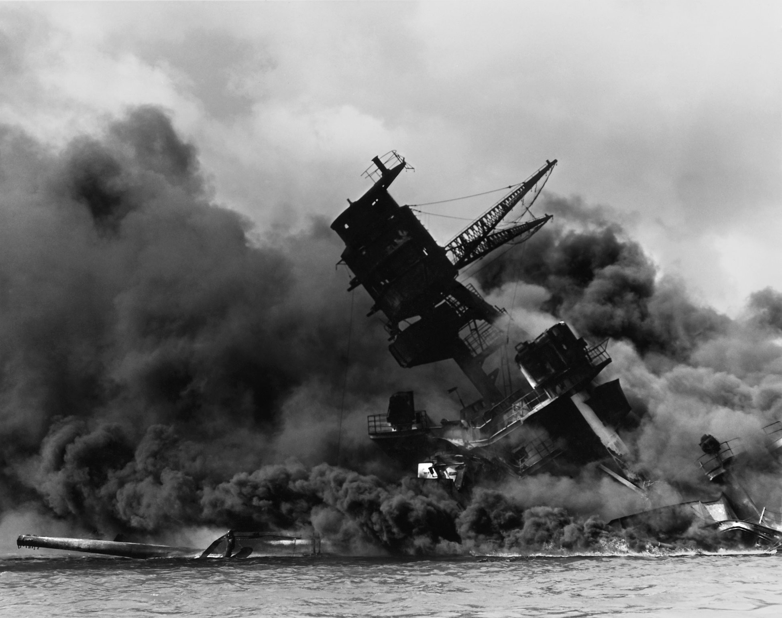
The USS Arizona after the Japanese surprise attack on Pearl Harbor.
© Brain Wrinkles

Slide 13
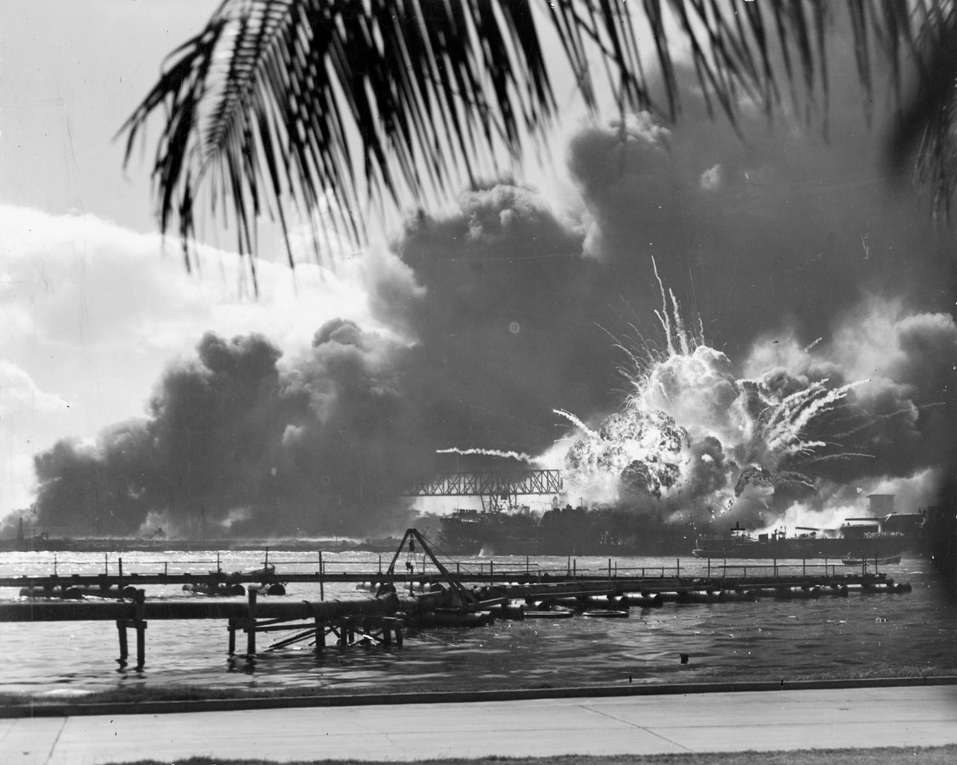
President Roosevelt called December 7, 1941, “a day that will live in infamy.”
© Brain Wrinkles

Slide 14
US Enters WWII
The next day, President Roosevelt asked Congress to declare war on Japan.
They agreed and the US officially entered WWII on December 8, 1941.
On December 11, Germany and Italy declared war on the US.
The US was now deeply involved in WWII on the side of the Allies.
© Brain Wrinkles

Slide 15
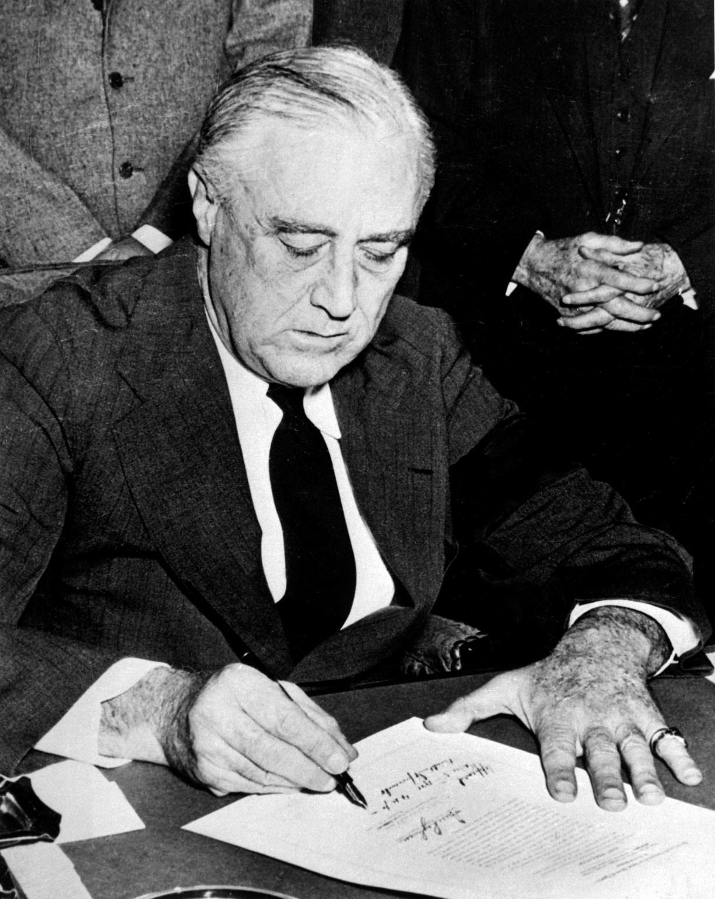
President Roosevelt Signing Declaration of War Against Japan.
© Brain Wrinkles

Slide 16
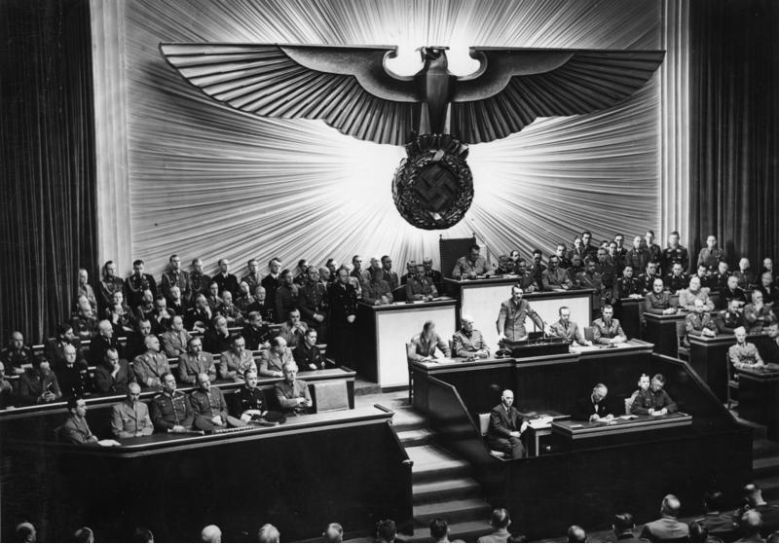
Hitler Declares War on the US – 1941.
© Brain Wrinkles

Slide 17
Island Hopping
In 1944, the US followed an “island-hopping” campaign in the Pacific.
US forces attacked island after island held by the Japanese.
This campaign brought American troops closer and closer to Japan.
© Brain Wrinkles

Slide 18
Kamikazes
Fighting Japan was difficult because the Japanese were fierce warriors.
The Japanese soldiers never gave up and were willing to sacrifice themselves for their country.
Japanese kamikaze pilots crashed their planes into US ships on purpose, fully expecting to die.
© Brain Wrinkles

Slide 19
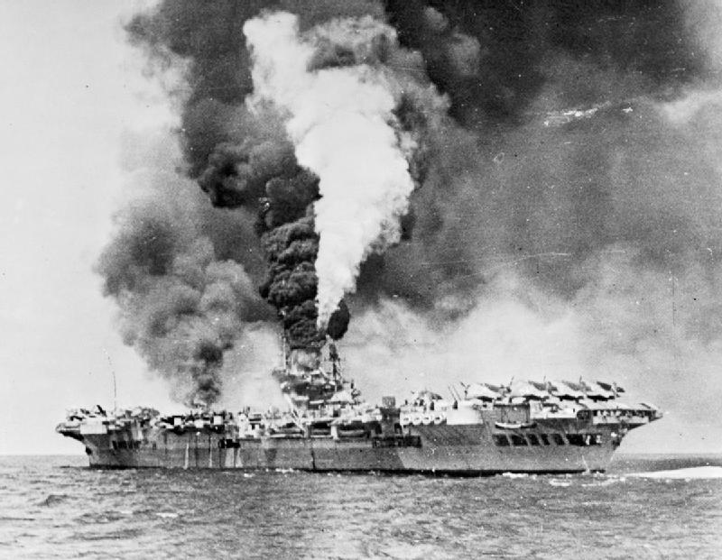
An Aircraft Carrier Hit By Kamikaze Planes
© Brain Wrinkles

Slide 20
Iwo Jima
In February 1945, American forces invaded the island of Iwo Jima.
The island was important because it was close to Japan and it was a good place for US planes to land.
The Japanese protected the island with traps and underground tunnels.
It was a fierce battle, but the US Marines eventually took the island.
© Brain Wrinkles

Slide 21
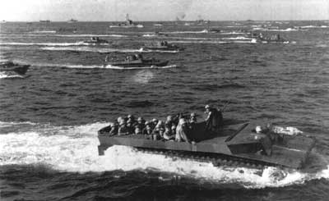
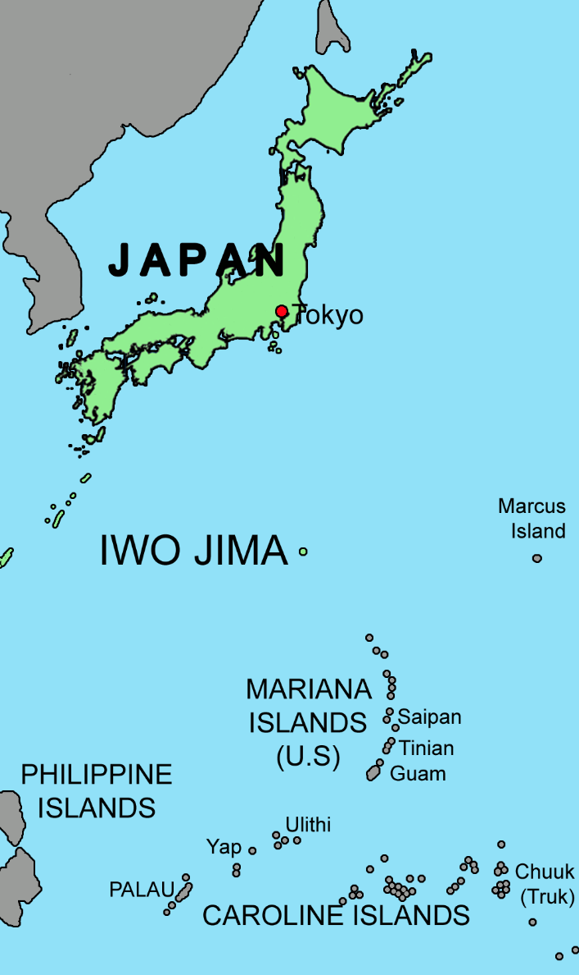
US Marines Approach Iwo Jima
© Brain Wrinkles

Slide 22
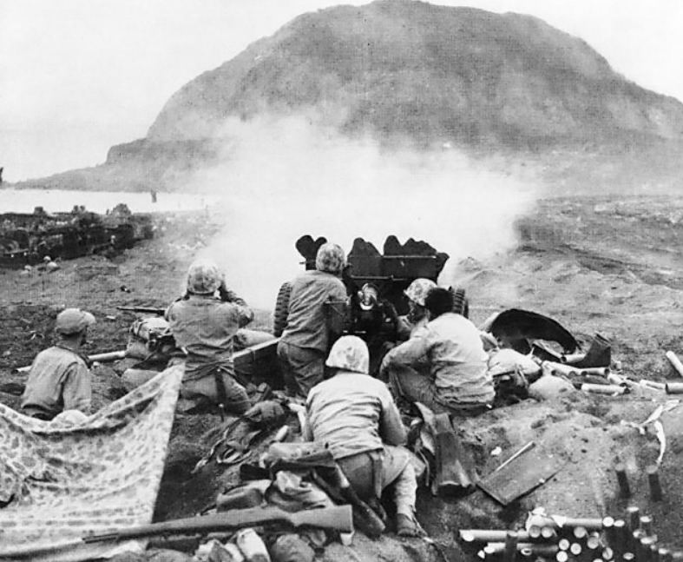
US Marines Fire at Japanese Cave Positions in Iwo Jima.
© Brain Wrinkles

Slide 23
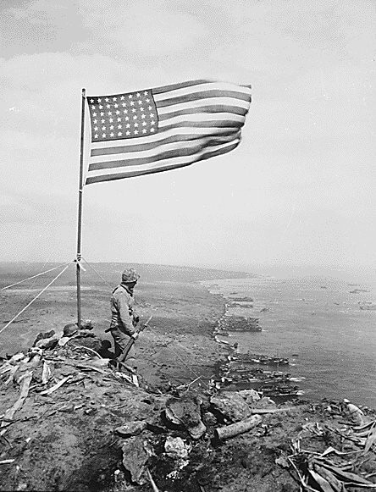
US Marines finally reached the highest point on the island and raised the American flag in victory.
© Brain Wrinkles

Slide 24
Atomic Bombs
The Allies thought about invading Japan, but were worried that too many soldiers would die.
President Harry Truman made a difficult decision to use nuclear weapons against Japan.
He warned the Japanese government to surrender, but they refused to give up.
© Brain Wrinkles

Slide 25
Atomic Bombs
On August 6, 1945, an American bomber plane dropped the first atomic bomb ever used in war on the Japanese city of Hiroshima.
A few days later, the US dropped a second bomb on Nagasaki.
Both cities were completely devastated, and the Japanese finally agreed to surrender.
Japan is the only country in the world that has been attacked by nuclear weapons.
© Brain Wrinkles

Slide 26
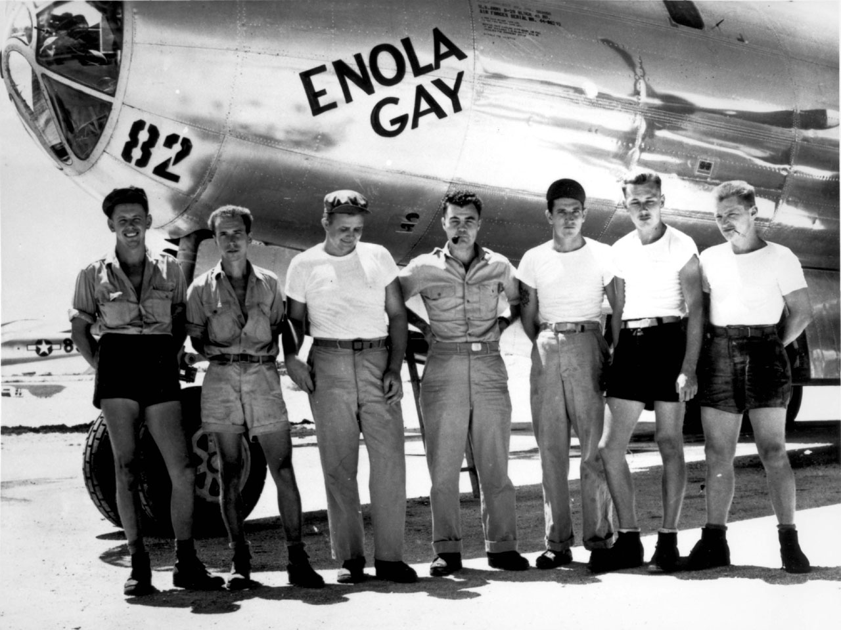
The Enola Gay dropped the “Little Boy” Atomic Bomb on Hiroshima.
© Brain Wrinkles

Slide 27
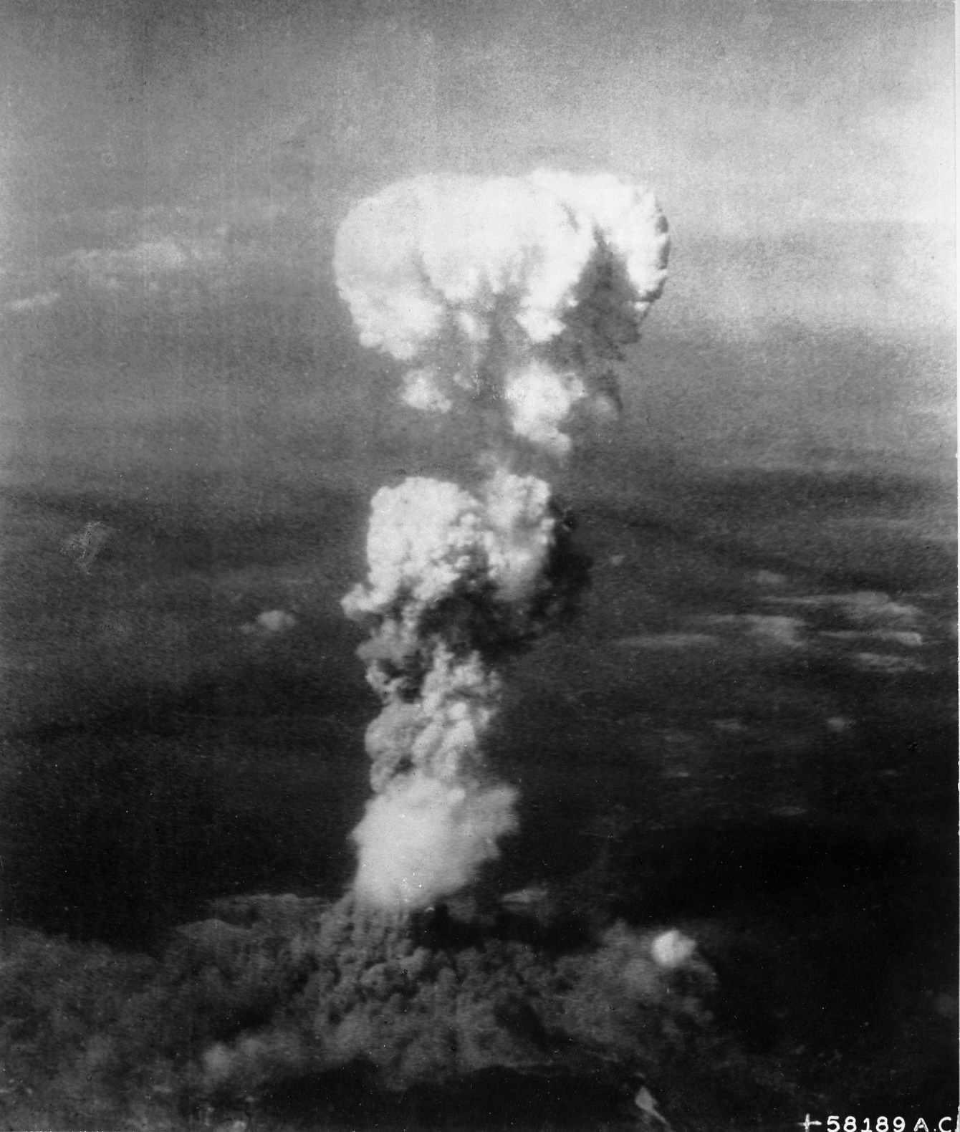
Mushroom Cloud Over Hiroshima
© Brain Wrinkles

Slide 28
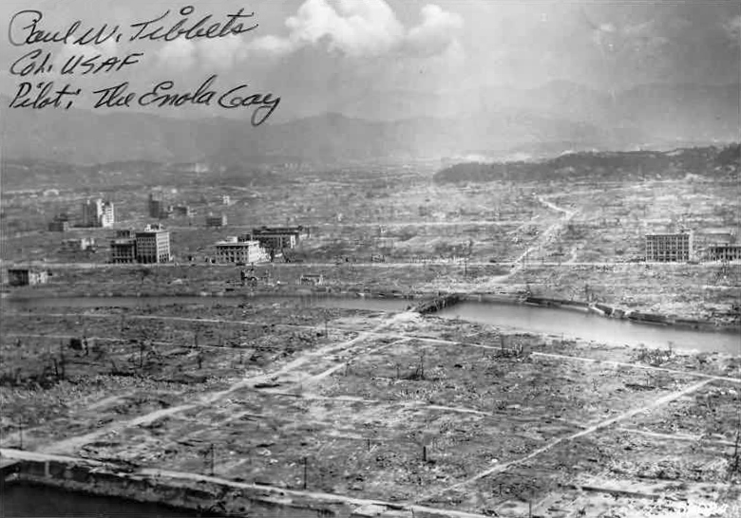
Hiroshima Aftermath
© Brain Wrinkles

Slide 29
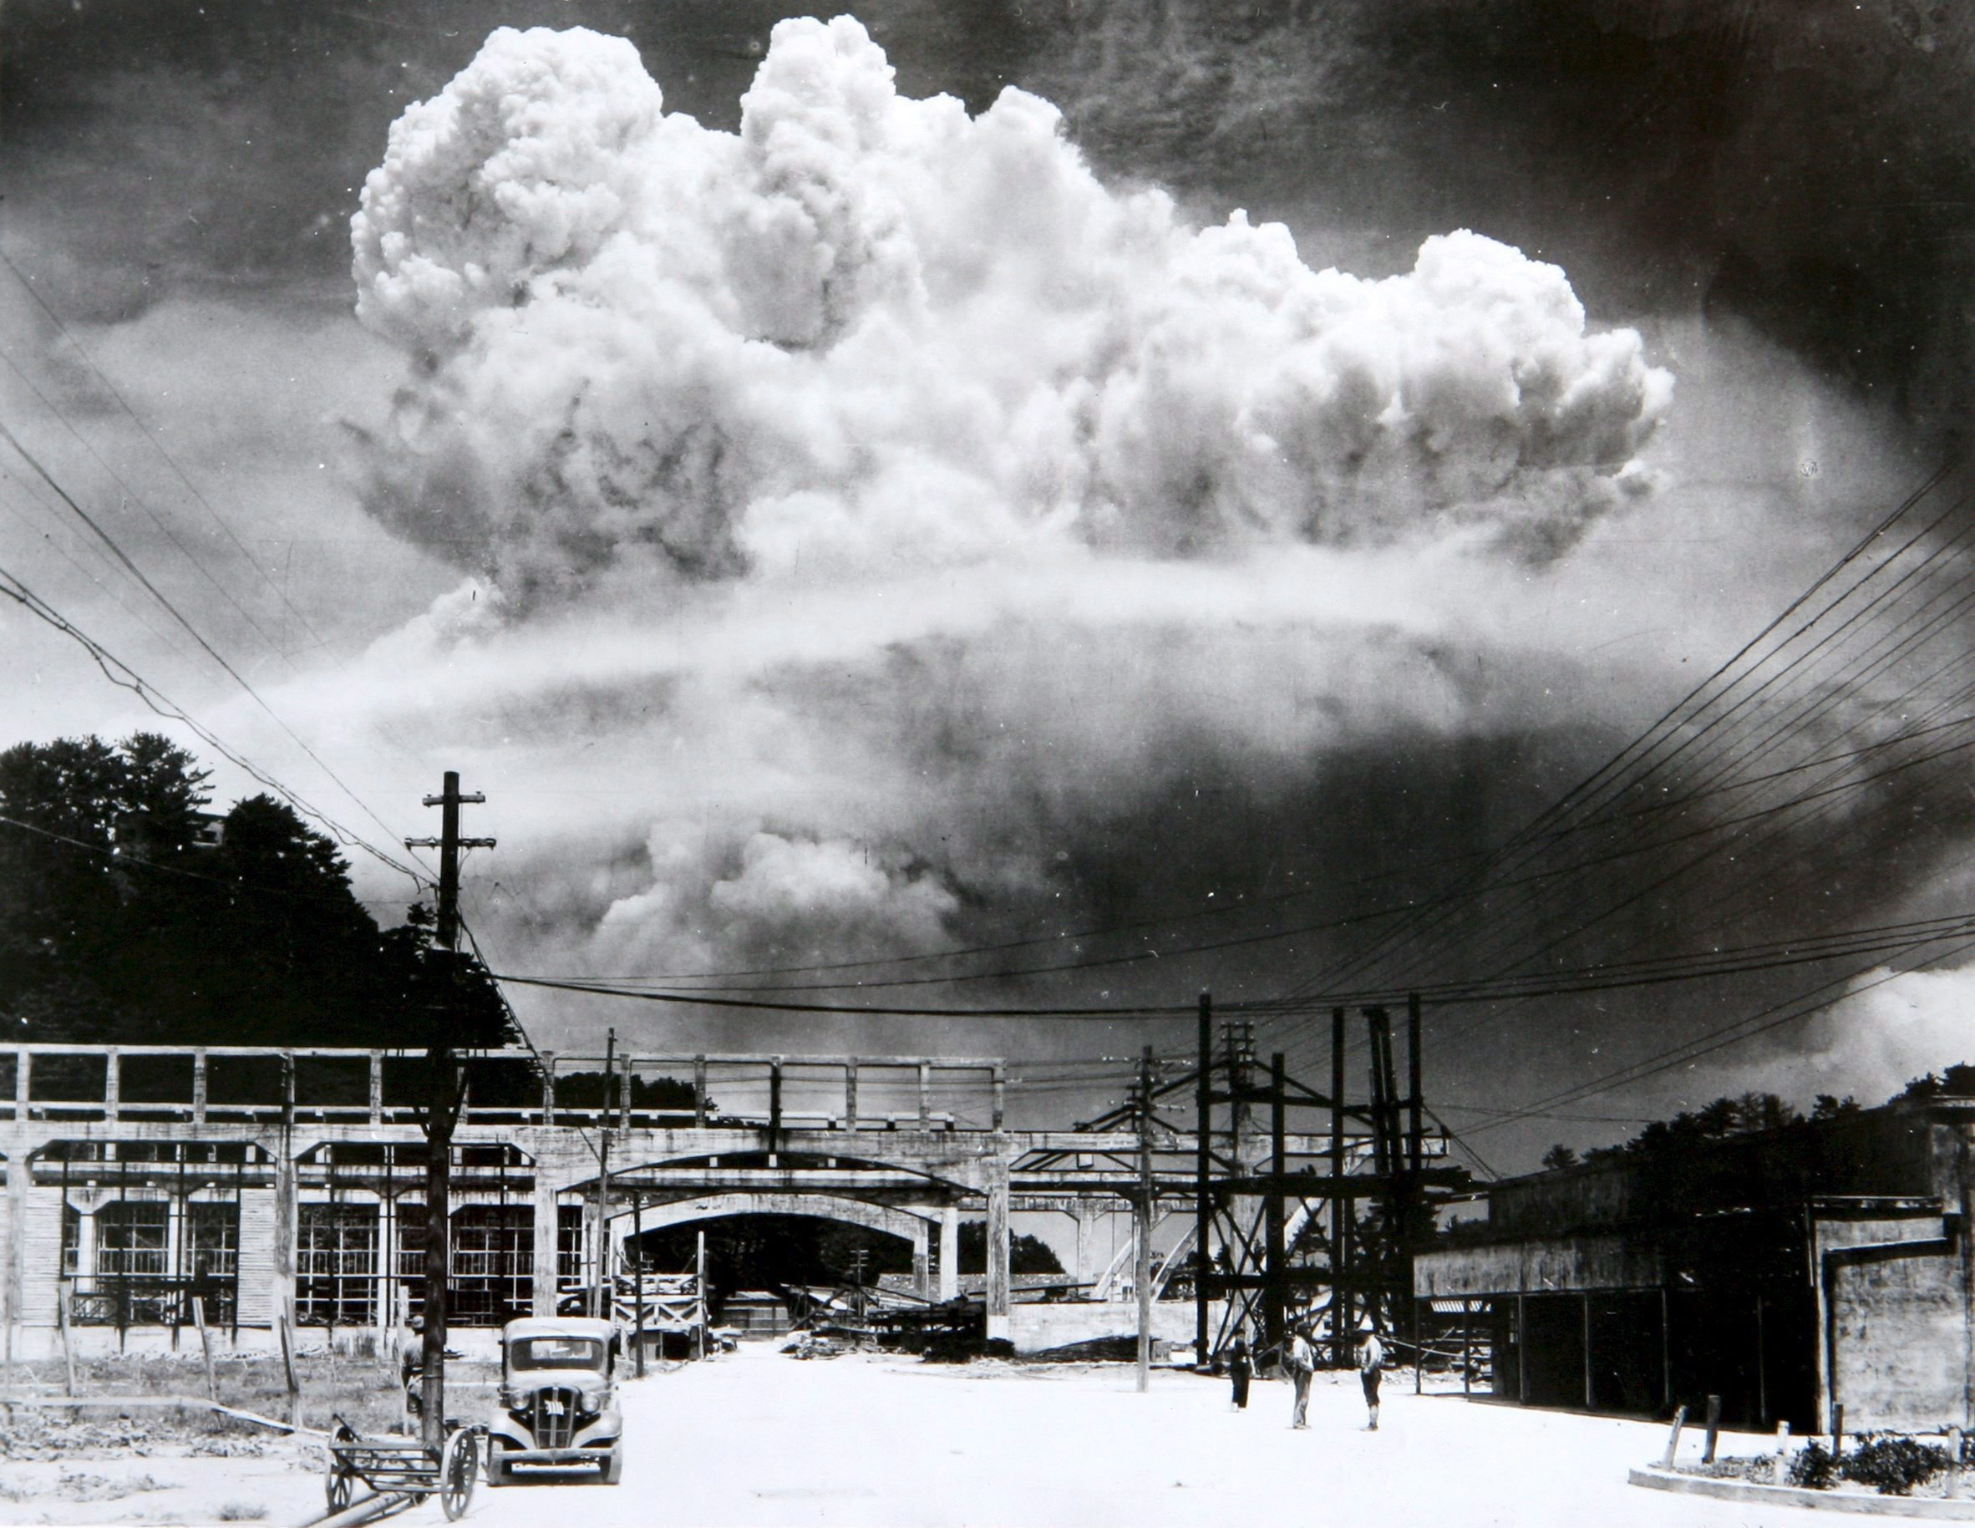
Mushroom Cloud Over Nagasaki
© Brain Wrinkles

Slide 30
VJ Day
The two sides signed formal surrender papers on the US battleship Missouri on September 2, 1945.
This day is known as VJ Day – Victory in Japan Day– and it officially put an end to Japan’s empire-building.
© Brain Wrinkles

Slide 31
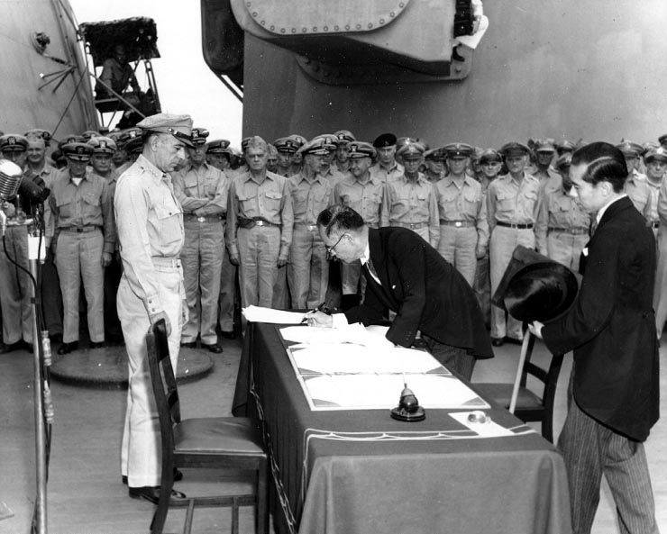
Japan Surrenders Aboard the USS Missouri,
September 2, 1945
© Brain Wrinkles

Slide 32
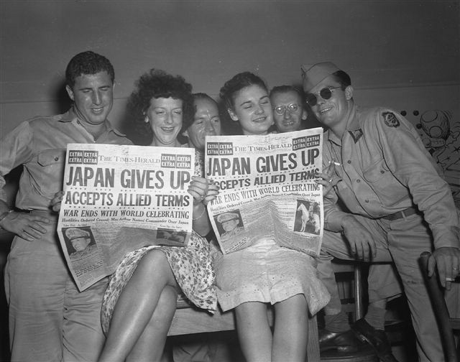
© Brain Wrinkles

Slide 33
Rebuilding
JAPAN
© Brain Wrinkles

Slide 34
Destruction
After Japan’s surrender, Japan’s economy and government were devastated.
The country’s infrastructure (transportation, communication, sewage, water, and electric systems) was demolished.
Industries and farms were destroyed and the emperor was exposed as a mere mortal and not a god.
© Brain Wrinkles

Slide 35
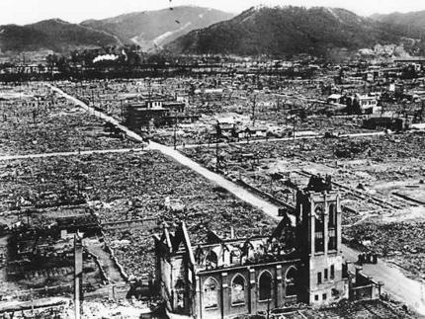
© Brain Wrinkles

Slide 36
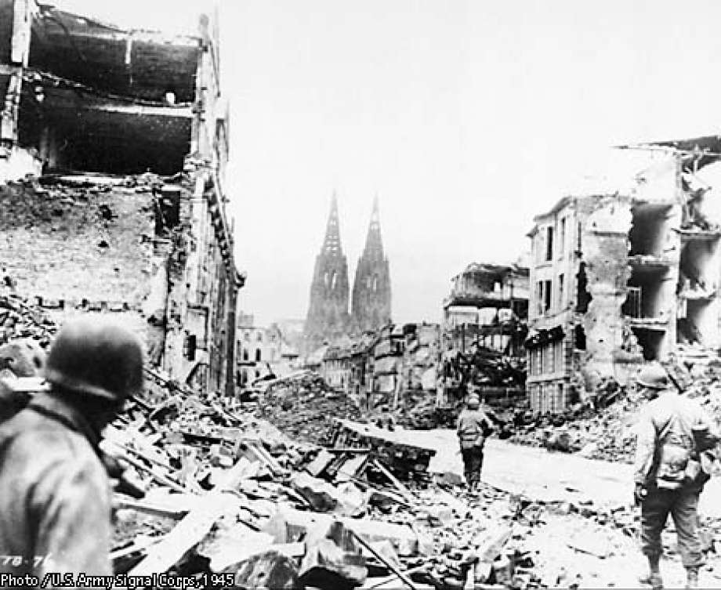
© Brain Wrinkles

Slide 37
Occupation
The US had a plan to occupy and rebuild Japan in a way that would guarantee the country would not pose a military threat to others in the future.
General Douglas MacArthur, who had commanded the Allied forces in the Pacific, was sent to oversee Japan’s restoration.
After World War II, the US occupied Japan from 1945 to 1952.
© Brain Wrinkles

Slide 38
MacArthur
General MacArthur ordered Japan’s military to be disbanded and closed all weapons factories.
He also directed that government and military leaders involved in World War II were brought to trial and punished.
In addition, MacArthur helped Japan install a new democratic government.
© Brain Wrinkles

Slide 39
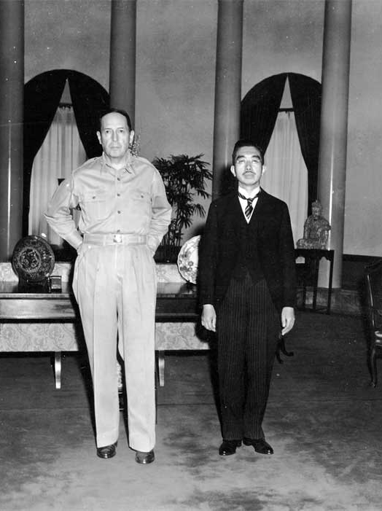
General Douglas MacArthur
and
Emperor Hirohito
© Brain Wrinkles

Slide 40
Government
MacArthur decided that Japan would be a constitutional monarchy in order to preserve the emperor’s role in the country’s culture.
He wrote Japan’s constitution, The MacArthur Constitution, which is still considered one of the most democratic documents in the world today.
Japanese citizens were granted many of the same rights as American citizens.
© Brain Wrinkles

Slide 41
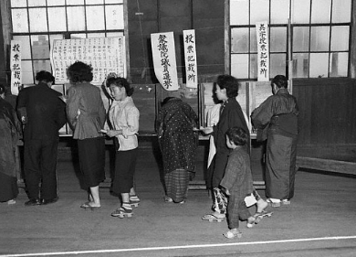
Elections in Tokyo
1952
© Brain Wrinkles

Slide 42
Reparations
Japan’s constitution also prevents the country from declaring war or fighting with other countries (unless they are attacked first).
After signing the new constitution, the Japanese government pledged to pay reparations to the countries that they harmed during WWII.
The Japanese were also not allowed to rebuild their military in any way.
© Brain Wrinkles

Slide 43
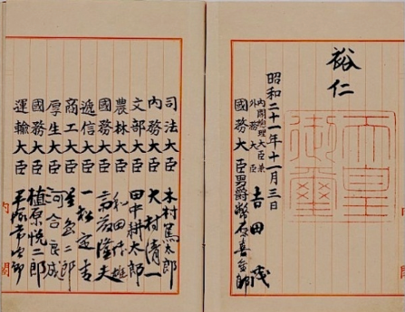
Japan’s Constitution
© Brain Wrinkles

Slide 44
Support
The United States offered financial support to help kick start Japan’s economy after World War II.
The US invested several billion dollars into rebuilding Japan.
Not all Americans supported the expense, but the government had its reasons to help Japan rebuild.
The US government knew that a friendly Japan would be a valuable trading partner in the future.
© Brain Wrinkles

Slide 45
Communism
The US government also wanted a democratic government to counteract the spread of Communism in Southern and Eastern Asia.
Communism was getting more and more popular in China, Korea, and Vietnam.
The US government saw this as a threat to democracy, and desired to keep the Japanese from being drawn to Communism.
© Brain Wrinkles

Slide 46
Economy
The United States’ efforts, coupled with a strong Japanese work ethic, led to a boom in Japan’s economic growth.
Japan now has one of the most powerful industrialized economies in the world.
America’s occupation and MacArthur’s rebuilding of Japan has had a positive lasting effect.
© Brain Wrinkles

Slide 47
Today
On April 28, 1952, Japan became a fully sovereign nation.
Today, the country has one of the most stable democratic governments in the world.
The US and Japan have remained close allies and trade partners since the 1950s.
© Brain Wrinkles

Slide 48
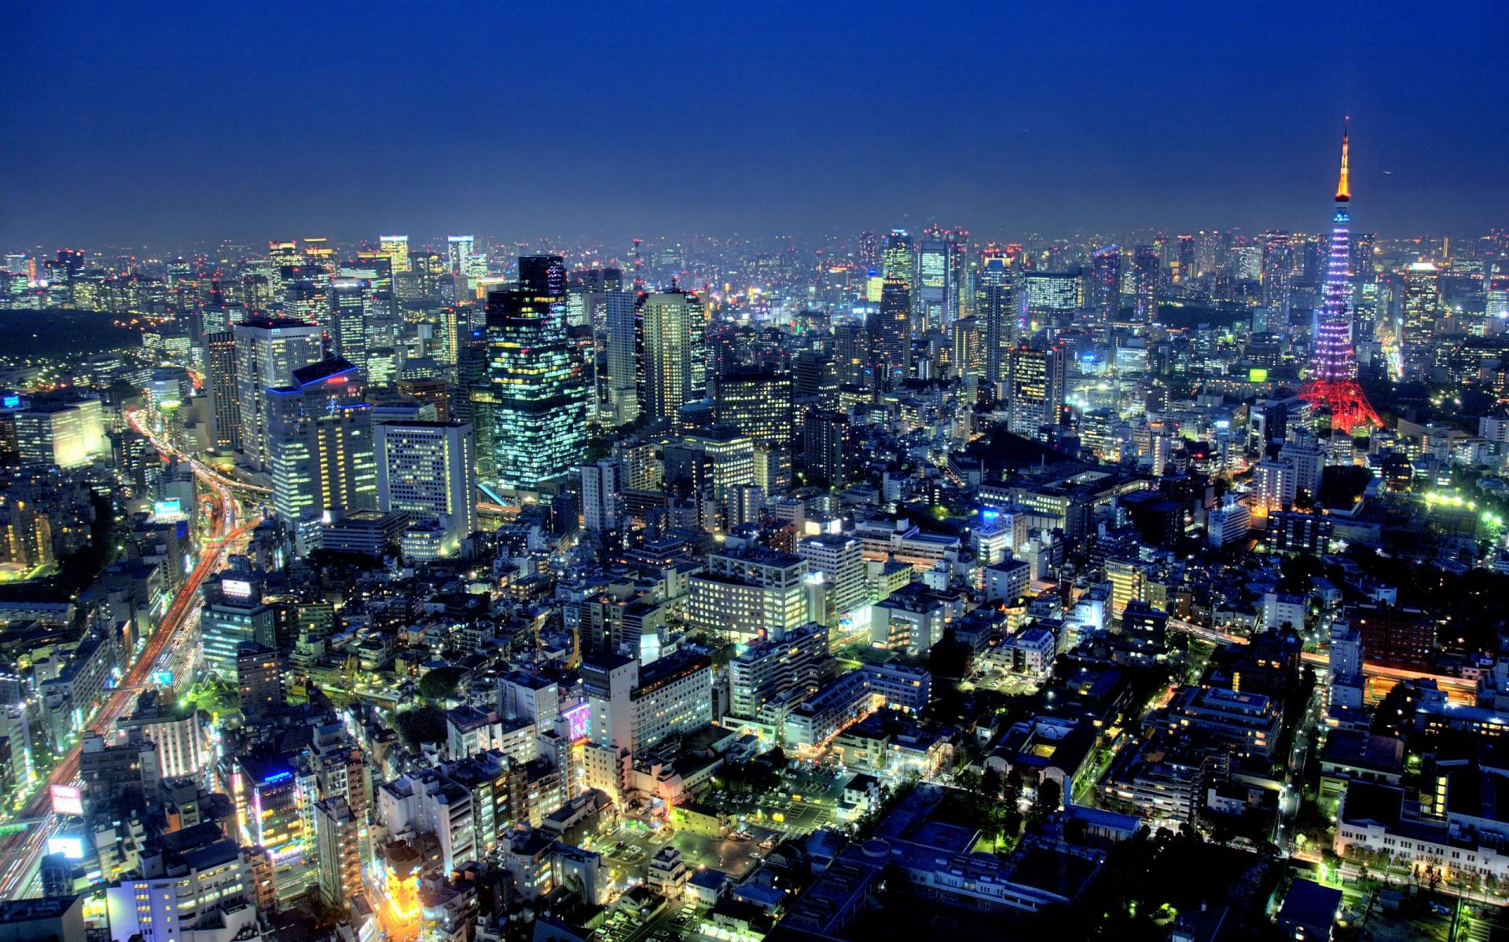
Tokyo, Japan
© Brain Wrinkles

Slide 49
1. What happened on December 7, 1941?
2. How did the US react to the Japanese bombing of Pearl Harbor?
3. Why did President Truman decide to drop the atomic bombs on Japan?
4. On which Japanese city was the first atomic bomb ever used in war dropped?
5. The Japanese surrendered after the second atomic bomb was dropped on this city:
6. The day that Japan surrendered is known as:
7. Why did the US occupy Japan from 1945 to 1952?
8. Who was given the task of rebuilding Japan?
9. What type of political system was established in Japan after the war?
10. What does Japan’s new constitution say about war?
11. What did the US government fear might happen if Japan’s economy remained weak?
12. Name 3 Asian countries where Communism was growing in popularity:
13. Was the United States successful in helping rebuild Japan’s economy? Explain.
14. What is the relationship like between the United States and Japan today?
15. What do you think Japan would look like today if the U.S. had not helped in the rebuilding process?
© Brain Wrinkles
Rebuilding Japan
Comprehension Check

